Slide 1
FINANCIAL
SALES
DATA
Sales Analysis Using Excel
PROFIT
DATA
Exploring financial performance across products, countries, segments and years
TRENDS
DATA
FINANCIAL PERFORMANCE • EXCEL ANALYSIS
Tools: • Microsoft Excel • PivotTables • Charts • Slicers
Prepared by: Priyanka Asalekar

Slide 2
Project Overview
An Excel-based analysis of financial sales data.
This project explores 700 financial transaction records across 16 fields using Microsoft Excel to analyze sales, profit, discounts and cost of goods sold across products, countries, segments and time periods.
PivotTable summaries compare profit by product and segment, sales by country and year, and product-level sales, discounts and profit.
PROJECT FILE
DATASET
Project Financial Sample.xlsx
Financial Sample Dataset.xlsx
FINANCIAL SALES ANALYSIS • 02

Slide 3
Project Objectives
Use spreadsheet summaries to review financial performance and compare business dimensions.
1
Analyze sales, profit, discounts and COGS in the financial dataset.
2
Compare profit across products and customer segments.
Compare sales across countries and years to identify differences over time.
3
Summarize sales, discounts and profit by product to support business review.
4
FINANCIAL SALES ANALYSIS • 03

Slide 4
Tools & Workflow
The workbook uses structured transaction data and PivotTable summaries.
TOOLS & TECHNOLOGY
WORKFLOW
• Microsoft Excel — data review and analysis
1
Open the Financial Sample dataset
2
Review fields and financial measures
• PivotTables — summarize data by product, country, segment and year
3
Use PivotTables to group and summarize records
• Excel formulas / numeric fields — sales, profit, discounts and COGS
4
Compare profit, sales and discounts across dimensions
• Charts and dashboard sheet — intended for visual presentation
5
Review results and present key comparisons
FINANCIAL SALES ANALYSIS • 04

Slide 5
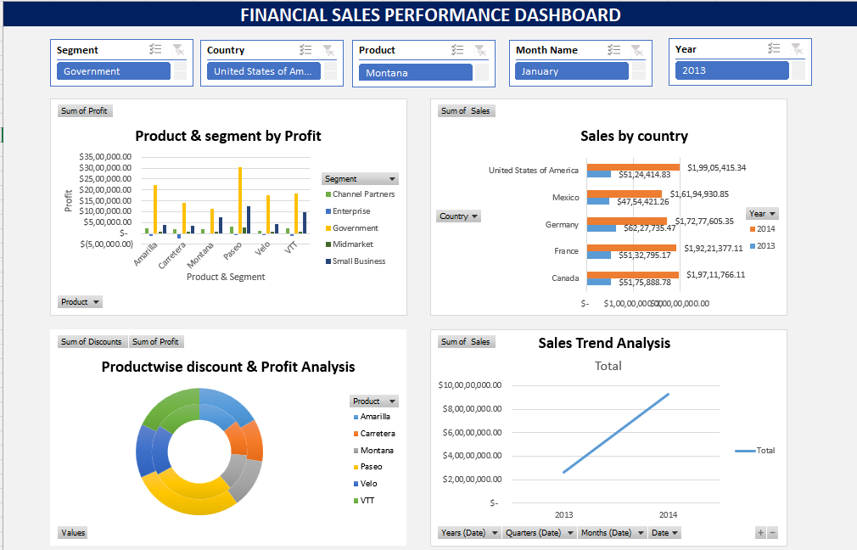
Project Visualizations
Interactive slicers: Segment • Country • Product • Month • Year
FINANCIAL SALES ANALYSIS • 05

Slide 6
Conclusion
Summary of the analysis and Excel skills demonstrated.
The Excel dashboard summarizes sales and profitability across products, countries, segments and years, turning transaction data into business comparisons.
KEY FINDINGS & EXCEL SKILLS
• Total sales: $118,726,350
• Total profit: $16,893,702
• Highest-profit product: Paseo ($4,797,438)
• Highest-sales country: United States of America ($25,029,830)
• Best Segment: Government
• Highest-sales Year:2014
• Skills: PivotTables, Pivot Charts, slicers and trend comparisons
FINANCIAL SALES ANALYSIS • 06

